Slide 1
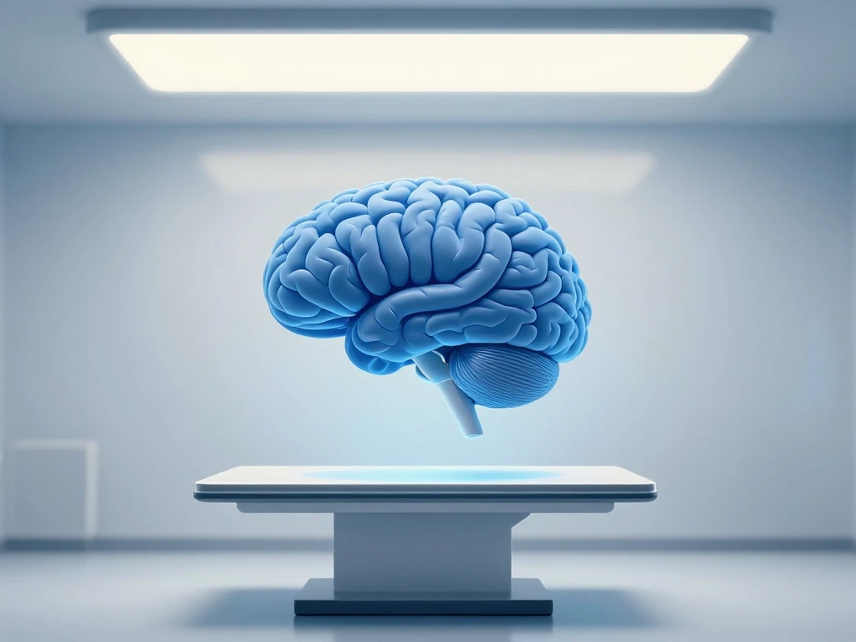
Chirag Somkuwar · Healthcare
Analytics Mini Project (CA-III) ·
Symbiosis Institute of Technology,
Nagpur
Predicting Dementia Using
Brain Scan Measurements
and Patient Health Data
A Person-Wise Validated, Explainable Machine Learning Study on OASIS

Slide 2
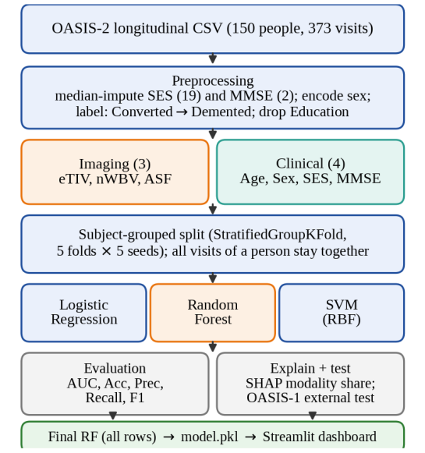
The Challenge of
Dementia Screening
Bridging the gap between brain scans and
clinical memory tests
Dementia is usually screened with either a brain scan or a
memory test (MMSE).
These two sources are rarely modeled together or compared
on equal terms.
This project builds a classifier using both brain scan
measurements and patient details.
Goal: Determine which data type the model leans on more
for accurate prediction.

Slide 3
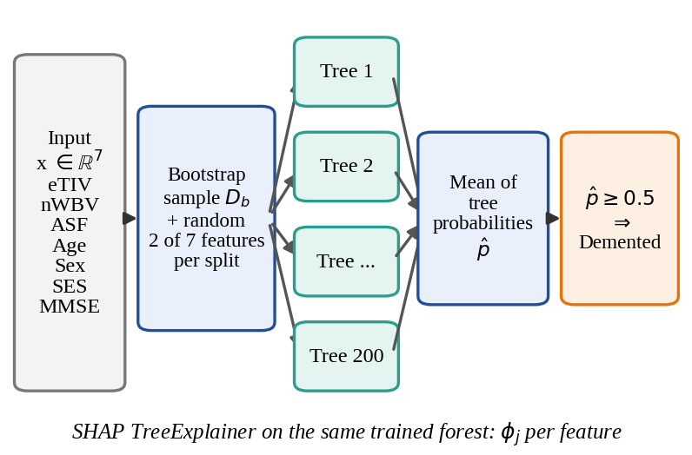
The OASIS Datasets
Utilizing longitudinal and cross-sectional MRI
studies
OASIS-2
OASIS-1
Features
Exclusions
OASIS-2 (Training): 150
people, 373 visits, aged 60–
98.
OASIS-1 (External Test): 198
records of people aged 60+
with CDR scores.
3 Brain scan measurements
(eTIV, nWBV, ASF) and 4
Patient details (Age, Sex,
SES, MMSE).
CDR and Education were
excluded to avoid data
leakage and maintain
consistency.

Slide 4
Person-Wise
Validation Protocol
Avoiding data leakage by keeping subject
visits together
Standard random
splits
StratifiedGroupKFold
Repeated over five
seeds
Strict evaluation
Ensures all visits of one
person stay in the same
fold.
Strict evaluation prevents
optimistic but misleading
accuracy scores.
Standard random splits can
put the same person in
both training and test sets.
Repeated over five seeds to
ensure stability and
measure performance
spread.

Slide 5
Machine Learning
Classifiers
Comparing linear and non-linear modeling
approaches
Logistic Regression
Random Forest
Support Vector
Machine
Models

Slide 6
Classifier Performance on OASIS-2
SVM (RBF): AUC 0.781.
Linear models performed better likely due to
the small sample size and strong MMSE
signal.
Logistic
Regression
Random
Forest
0.851
0.786
Strongest model
for this cohort
Model performance
on the OASIS-2
dataset

Slide 7
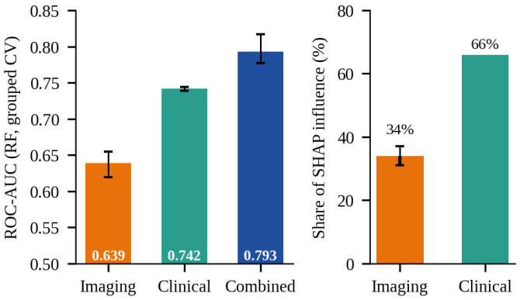
Imaging vs. Clinical
Data
Combined data provides the most robust
prediction
Imaging Only
Clinical Only
Combined
Adding scan
measurements
AUC 0.639 (Weakest
performance).
AUC 0.742.
AUC 0.793.
Adding scan
measurements to patient
details gives a measurable
gain of 0.051 AUC.

Slide 8
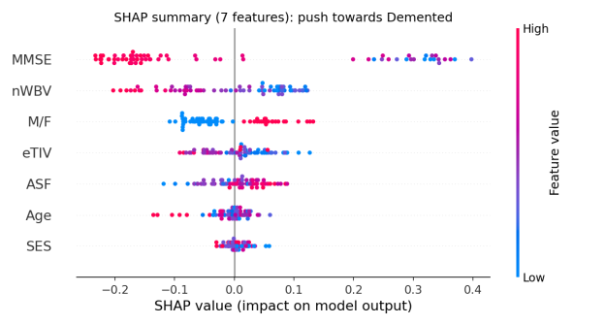
SHAP Global
Interpretability
Quantifying the influence of clinical vs.
imaging features
Clinical Share
Imaging Share
MMSE
SHAP values
66% of model influence
(dominated by MMSE).
34% of model influence
(dominated by nWBV).
MMSE is the strongest
individual predictor,
followed by brain volume
(nWBV).
SHAP values confirm that
clinical features carry about
two-thirds of the signal.

Slide 9
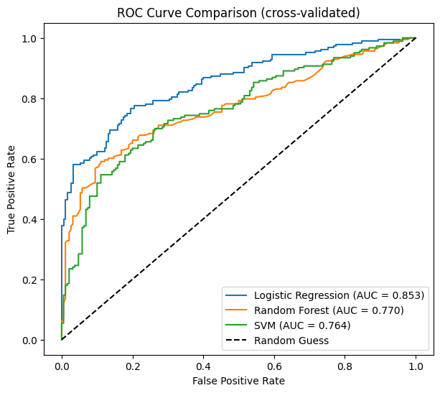
Generalization on
OASIS-1
Random Forest shows superior performance
on independent data
Models trained
Random Forest
Logistic
Regression
SVM
Demonstrates
Models trained on
OASIS-2 were tested
once on the OASIS-1
cohort.
AUC 0.938 (Strongest
generalization).
AUC 0.891.
Demonstrates that
models carry over
well to different
cohorts with AUC
near 0.9.
AUC 0.896.

Slide 10

Streamlit
Dashboard
Interactive risk prediction and explainability
Deployed
Users can
Provides a
Includes example
profiles
Deployed as a live web
application for real-time
predictions.
Users can adjust sliders for
brain scan and clinical
measurements.
Provides a risk estimate and
a SHAP chart for individual
explanations.
Includes example profiles to
demonstrate model
behavior.

Slide 11

Benchmarking
Against Published
Studies
Why stricter validation leads to more realistic
scores
Many papers
This study
Avoiding data leakage
Many papers report 90%+ accuracy by
using CDR as an input or random
splits.
This study reports lower scores due to
person-wise validation and removing
CDR.
Avoiding data leakage provides a
more honest assessment of real-world
performance.

Slide 12

Key Findings and
Future Work
Advancing dementia prediction through
multimodal, explainable AI
Combining scans
Clinical details
Future Work
Combining scans and clinical data is
superior to using either alone.
Clinical details provide ~2/3 of the
signal, but scans add significant value.
Larger datasets, hyperparameter
tuning, and predicting conversion in
follow-up visits.

